Slide 1
BGP and Transport Layer (TCP and UDP)
CSE 405 January 2025 - Lecture 6
Special Thanks to Peyrin Kao (UC Berkeley)
Notes:
3 letter acronyms joke
Building on

Slide 2
Last Time: Low-Level Network Attacks
Classes of attackers:
Off-path: Can’t see, modify, or drop packets
On-path: Can see packets, but can’t modify or drop packets
MITM: Can see, modify, and drop packets
ARP: A protocol to translate local IP addresses to MAC addresses
Ask everyone on the network, “Who has the IP 1.2.3.4?”
Attack: The attacker can respond instead of the true device with 1.2.3.4, and packets will get routed to the attacker!
Defense: Switches
Defense: Rely on higher layers
DHCP: A protocol for a new client to receive a network configuration
Ask everyone on the network, “What is the network configuration to use?”
Attack: The attacker can respond with a malicious configuration
Defense: Rely on higher layers
Notes:
Start narrative on defense in depth

Slide 3
Today: Layers 3 and 4
Border Gateway Protocol (BGP): Routing -- determining what path packets should take
Transmission Control Protocol (TCP): Reliably sending packets
User Datagram Protocol (UDP): Non-reliably sending packets

Slide 4
Border Gateway Protocol (BGP)
Textbook Chapter 29

Slide 5
Review: Internet Protocol (IP)
Internet Protocol (IP): The universal layer-3 protocol that all devices use to transmit data over the Internet
IP address: An address that identifies a device on the Internet
IPv4 is 32 bits (e.g. 35.163.72.93)
IPv6 is 128 bits (e.g. 2607:f140:8801:0000:0000:0000:0001:0023)
Shorthand: omit sets of zeros: 2607:f140:8801::1:23
Globally unique from any single perspective
For now, you can think of them as just being globally unique
IP addresses help nodes make decisions on where to forward the packet
Notes:
Question: Recall what are the layers of the networks?
A: 1 - Physical 2 - Link 3 - internetwork (IP)
Start on

Slide 6
Subnets
Recall: An IP packet might make many hops across different routers before it can reach its destination
IP routes by subnets, which are groups of addresses with a common prefix
A subnet is written as a prefix followed by the length of the prefix (in bits)
Example: 128.32.0.0/16 is an IPv4 subnet with all addresses that begin with the prefix of 128.32.*
Since an IPv4 is a 32-bit address and there are 16 bits in the prefix, this subnet represents 2³² ⁻ ¹⁶ = 2¹⁶ addresses

Slide 7
Routing Packets
To send a packet to a computer within the local network:
Verify that the destination IP is in the same subnet
Use ARP (or contact a switch) to get the destination MAC address
Send the packet directly to the destination using the destination MAC address
To send a packet to a computer that is not within the local network:
Send the packet to the gateway router
Past the gateway router, the packet goes to the Internet
It’s the gateway router’s job to deliver the packet closer to the destination

Slide 8
Autonomous Systems
Once your system sends the packet to the gateway, the packet has to be routed through the Internet
The Internet is a network of networks, comprised of many autonomous systems (AS)
Each AS handles its own internal routing
Each AS is uniquely identified by its autonomous system number (ASN)
Each AS is comprised of one or more LANs
Each AS can forward packets to other connected ASes
The protocol for communicating between different Autonomous Systems is Border Gateway Protocol (BGP)
Each router announces what networks it can deliver to and the path onward from the router
The most precise route with the shortest path and no loops is the preferred route

Slide 9
BGP
I can reach {AS4->AS6->Recipient}
I can reach {AS5->AS6->Recipient}
I can reach {AS6->Recipient}
AS 5
Recipient
AS 1
AS 3
AS 6
AS 2
I can reach {Recipient}
Sender
AS 4
I can reach {AS4->AS6->Recipient}
I can reach {AS6->Recipient}
Notes:
Note that AS1 has a choice of whether to use AS2, AS3, or AS4. It chooses AS4 since AS4 provides the most direct path. If the AS1-AS4 link drops, AS1 will recalculate and choose either AS1->AS3->AS5->AS6 or AS1->AS2->AS4->AS6. So the decision of which path to choose is a dynamic problem that has to be continuously calculated. You cannot figure out the path before, thats the point of hop by hop.

Slide 10
IP and BGP Attacks
Each AS implicitly trusts the surrounding ASes and accepts advertised routes
IP spoofing: Malicious clients can send IP packets with source IP values set to a spoofed value
Enables packets that look like they’re coming from someone else!
Edge ASes should block packets with source IPs set to the wrong value, but some don’t
We rely on defenses provided by higher layers to further prevent this (“defense in depth”)
BGP hijacking: A malicious autonomous system can lie and claim itself to be responsible for a network which it isn’t
Example: AS3 broadcasts that it is responsible for 128.32.0.0/16
Now, the malicious AS can act as a MITM for traffic to 128.32.0.0!
No real defenses on this level, so we rely on defenses from higher levels

Slide 11
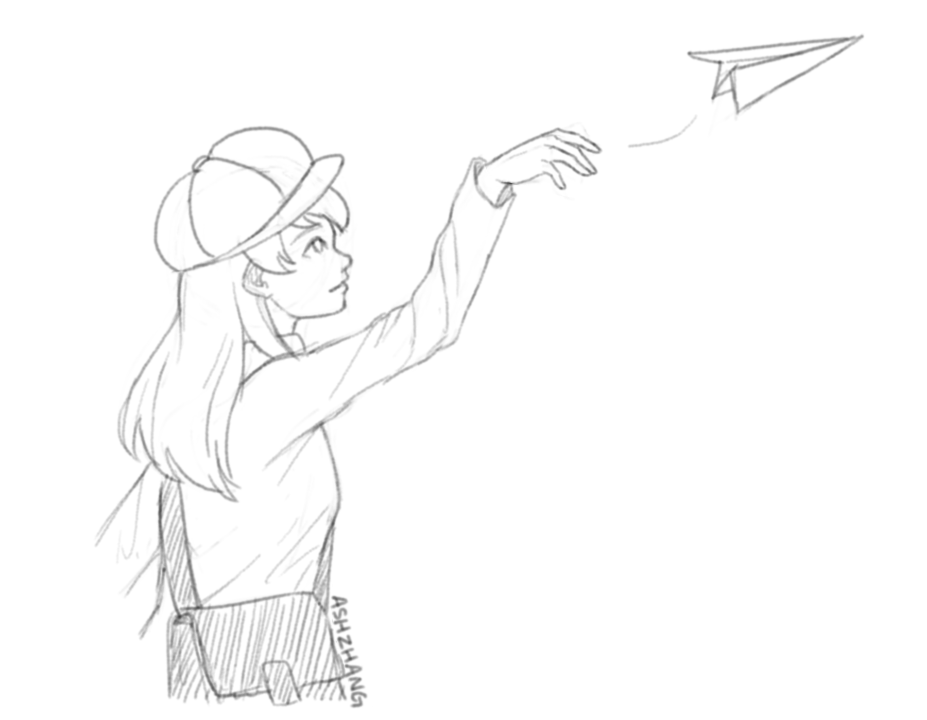
Transmission Control Protocol (TCP)
Textbook Chapter 30

Slide 12
Review: IP Reliability
IP is unreliable and only provides a best effort delivery service, which means:
Packets may be lost (“dropped”)
Packets may be corrupted
Packets may be delivered out of order
It is up to higher level protocols to ensure that the connection is reliable, i.e., that packets are received correctly
Packets that are changed (random error or malicious tampering) aren't considered correctly received
IP packets include a checksum (unkeyed function, protects against random errors)
However, there is no cryptographic MAC, so there are no guarantees if an attacker maliciously modifies packets (and modifies the checksum accordingly)

Slide 13
Scratchpad: Let’s Design It Together
Problem: IP packets have a limited size. To send longer messages, we have to manually break messages into packets
When sending packets: TCP will automatically split up messages
When receiving packets: TCP will automatically reassemble the packets
Now the user doesn’t need to manually split up messages!
Problem: Packets can arrive out of order
When sending packets: TCP labels each byte of the message with increasing numbers
When receiving packets: TCP can use the numbers to rearrange bytes in the correct order
Problem: Packets can be dropped
When receiving packets: TCP sends an extra message acknowledging that a packet has been received
When sending packets: If the acknowledgement doesn’t arrive, re-send the packet

Slide 14
Transmission Control Protocol (TCP)
Abstraction: a byte stream
Bytes go in one end of the stream at the source and come out at the other end at the destination
TCP automatically breaks streams into segments, which are sent as layer 3 packets
Provides ordering
Segments contain sequence numbers, so the destination can reassemble the stream in order
Provides reliability
The destination sends acknowledgements (ACKs) for each sequence number received
If the source doesn’t receive the ACK, the source sends the packet again
Provides ports
Multiple services can share the same IP address by using different ports

Slide 15
Ports: An Analogy
Alice is pen pals with Bob. Alice’s roommate, Carol, is also pen pals with Bob
Bob’s replies are addressed to the same global (IP) address
How can we tell which letters are for Alice and which are for Carol?
Solution: Add a room number (port number) inside the letter
In private homes, usually a port number is meaningless
But, in public offices (servers), like Cory Hall, the port numbers are constant and known

Slide 16
Ports
Ports help us distinguish between different applications on the same computer or server
On private computers, port numbers can be random
On public servers, port numbers should be constant and well-known (so users can access the right port)
Remember: TCP is built on top of IP, so the IP header (and therefore the IP address) is still present
IP Header: send to: 1.2.3.4
TCP Header: send to: port 80
I am hungry.
Notes:
Hammer in the concept that we build messages from high to low so headers of higher layers are put first into the message packets so therefore end up “below” the headers of the lower layers

Slide 17
Establishing Sequence Numbers
Each TCP connection requires two sets of sequence numbers
One sequence number for messages from the client to the server
One sequence number for messages from the server to the client
Before starting a TCP connection, the client and server must agree on two initial sequence numbers (ISNs)
The ISNs are different and random for every connection (for security reasons, as we’ll see soon)
H | e | l | l | o |  | s | e | r | v | e | r
50 | 51 | 52 | 53 | 54 | 55 | 56 | 57 | 58 | 59 | 60 | 61
Messages from the client are numbered starting at 50.
H | e | l | l | o |  | c | l | i | e | n | t
25 | 26 | 27 | 28 | 29 | 30 | 31 | 32 | 33 | 34 | 35 | 36
Messages from the server are numbered starting at 25.

Slide 18
TCP: 3-Way Handshake
Client chooses an initial sequence number x for bytes it will send and sends a SYN (synchronize) packet to the server
Client
Server
SYN. Seq = x
Server chooses an initial sequence number y for bytes it will send and responds with a SYN-ACK packet
SYN-ACK. Seq = y, Ack = x+1
ACK. Seq = x+1, Ack = y+1
Client then returns with an ACK packet
Once both hosts have synchronized sequence numbers, the connection is “established”
Data

Slide 19
TCP: Sending and Receiving Data
The TCP handlers on each side track which TCP segments have been received for each connection
A connection is identified by these 5 values (sometimes called a 5-tuple)
Source IP
Destination IP
Source Port
Destination Port
Protocol (TCP)
Data from the bytestream can be presented to the application when all data before has been received and presented
Recall: TCP presents data to the application as a bytestream, so the order must be preserved from one end to the other, even if packets are received out of order

Slide 20
TCP: Sending and Receiving Data
Byte i of the bytestream is represented by sequence number x + i
The first byte is byte i = 1, since sequence number x was used for the SYN packet and y for the SYN-ACK packet
A packet’s sequence number is the sequence number of the first byte of its data
This number is from the sender’s set of sequence numbers
A packet’s ACK number, if the ACK flag is set, is the sequence number of the byte immediately after the last received byte
This number is from the set of sequence numbers from the party who sent the data
This would be (sequence number) + (length of data) for the last received packet

Slide 21
TCP: Sending and Receiving Data
Client
Server
ACK. Seq = x+1, Ack = y+1. Data, length A
ACK. Seq = y+1, Ack = x+1+A. Data, length B
ACK. Seq = x+1+A, Ack = y+1+B. Data, length C
ACK. Seq = y+1+B, Ack = x+1+A+C. Data, length D
Notes:
TODO

Slide 22
TCP: Retransmission
If a packet is dropped (lost in transit):
The recipient will not send an ACK, so the sender will not receive the ACK
The sender repeatedly tries to send the packet again until it receives the ACK
If a packet is received, but the ACK is dropped:
The sender tries to send the packet again since it didn’t receive the ACK
The recipient ignores the duplicate data and sends the ACK again
When packets are dropped in TCP, TCP assumes that there is congestion and sends the data at a slower rate

Slide 23
TCP: Ending/Aborting a Connection
To end a connection, one side sends a packet with the FIN (finish) flag set, which should then be acknowledged
This means “I will no longer be sending any more packets, but I will continue to receive packets”
Once the other side is no longer sending packets, it sends a packet with the FIN flag set
To abort a connection, one side sends a packet with the RST (reset) flag set
This means “I will no longer be sending nor receiving packets on this connection”
RST packets are not acknowledged since they usually mean that something went wrong

Slide 24
TCP Flags
ACK
Indicator that the user is acknowledging the receipt of something (in the ack number)
Pretty much always set except the very first packet
SYN
Indicator of the beginning of the connection
FIN
One way to end the connection
Requires an acknowledgement
No longer sending packets, but will continue to receive
RST
One way to end a connection
Does not require an acknowledgement
No longer sending or receiving packets

Slide 25
TCP Packet Structure
Source Port (16 bits) |  |  |  | Destination Port (16 bits)
Sequence Number (32 bits)
Acknowledgement Number (32 bits)
Data Offset (4 bits) | Flags (12 bits) |  |  | Window Size (16 bits)
Checksum (16 bits) |  |  |  | Urgent Pointer (16 bits)
Options (variable length)
Data (variable length)
TCP segment header
Notes:
Notice: Ports, sequence number, ACK number, flags, checksum, and data

Slide 26
TCP Attacks
TCP hijacking: Tampering with an existing session to modify or inject data into a connection
Data injection: Spoofing packets to inject malicious data into a connection
Need to know: The sender’s sequence number
Easy for MITM and on-path attackers, but off-path attackers must guess 32-bit sequence number (called blind injection/hijacking, considered difficult)
For on-path attackers, this becomes a race condition since they must beat the sender
RST injection: Spoofing a RST packet to forcibly terminate a connection
Same requirements as packet injection, so easy for on-path and MITM attackers, but hard for off-path attackers
Often used in censorship scenarios to block access to sites

Slide 27
TCP Data Injection
Client
Server
ACK. Seq = x+1, Ack = y+1. Data, length A
This packet will be ignored by the client since the client already processed the malicious packet!
Seq = y+1. Evil data, length B
ACK. Seq = y+1, Ack = x+1+A. Real data, length B
Notes:
TODO

Slide 28
TCP Attacks
TCP spoofing: Spoofing a TCP connection to appear to come from another source IP address
Recall: IP packets can often be spoofed if the sender AS doesn’t block spoofed packets
The attacker will need to know the sequence number in the server’s response SYN-ACK packet
Easy for MITM and on-path attackers, but off-path attackers must guess 32-bit sequence number (called blind spoofing, also considered difficult)
For on-path attackers, this involves a race condition, since the real client will send a RST upon receiving the server’s SYN-ACK!

Slide 29
TCP Spoofing
SYN. Seq = x
Client
Server
SYN-ACK. Seq = y, Ack = x+1
ACK. Seq = x+1, Ack = y+1. Evil data
An on-path attacker must send the evil data before the server receives the real client’s RST!
RST. Seq = x+1
A MITM attack could just drop the client’s packets, however
Notes:
TODO

Slide 30
TCP Attacks
TCP provides no confidentiality or integrity
Instead, we rely on higher layers (like TLS, more on this next time) to prevent those kind of attacks
Defense against off-path attackers rely on choosing random sequence numbers
Bad randomness can lead to trivial off-path attacks: TCP sequence numbers used to be based on the system clock!

Slide 31
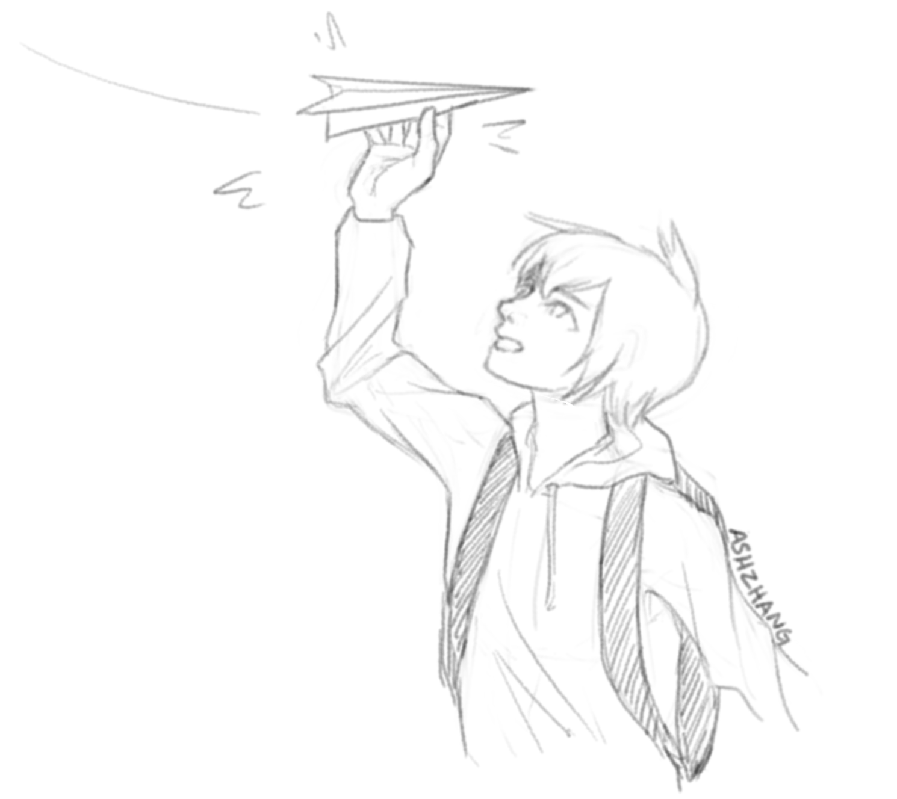
User Datagram Protocol (UDP)
Textbook Chapter 30

Slide 32
User Datagram Protocol (UDP)
Provides a datagram abstraction
A message, sent in a single layer 3 packet (though layer 3 could fragment the packet)
Max size limited by max size of packet
Applications break their data into datagrams, which are sent and received as a single unit
Contrast with TCP, where the application can use a bytestream abstraction
No reliability or ordering guarantees, but uses ports
Like IP, it provides best effort delivery
Faster than TCP, since there is no 3-way handshake
Usually used by low-latency, high-speed applications where errors are okay (e.g., video streaming, games)

Slide 33
UDP Attacks
No sequence numbers, so relatively easy to inject data into a connection or spoof connections
Higher layers must provide their own defenses against these attacks!

Slide 34
UDP Packet Structure
Source Port (16 bits) | Destination Port (16 bits)
Length (16 bits) | Checksum (16 bits)
Data (variable length)
UDP datagram header
Notes:
Notice: Ports, checksum, data

Slide 35
Summary
Border Gateway Protocol (BGP): Routing packets
The Internet is made of smaller autonomous systems (AS)
Each AS broadcasts the shortest routes it knows of (dependent on the shortest routes of its neighbors and distance to neighbors)

Slide 36
Summary
Transmission Control Protocol (TCP): Reliably sending packets
3-way handshake: Client sends SYN, server sends SYN-ACK, client sends ACK
Provides reliability, ordering, and ports
Attack: TCP hijacking through data injection or RST injection
Blind attacks must guess the client’s or server’s sequence numbers
Attack: TCP spoofing by sending a spoofed SYN packet
Blind attacks must guess the server’s sequence number
User Datagram Protocol (UDP): Non-reliably sending packets
No reliability or ordering, only ports
Same injection and spoofing attacks as TCP, but easier

